Slide 2

The Highlights

Slide 3
Team

Slide 4




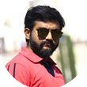

Team Highlights
Name | Location
Aanchal Lohia | Mumbai, India
Ravishekhar Gopalan | Toronto, Canada
Chetan Urkudkar | Dublin, USA
Pankaj Khairnar | Mumbai, India
Prashant Hattiholi | Pune, India

Slide 5
Realization

Slide 6
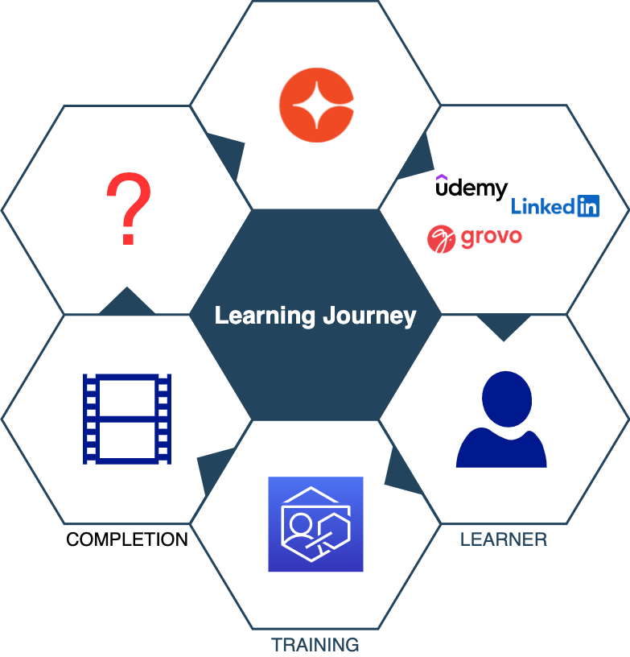
Learning Journey

Slide 7
Completion is a milestone!

Slide 8
Journey does not end here…
Cornerstars bring best-in-class learning to learners on our platform
Learners love our excellent content.
Variety of formats on a range of devices
What about after the learner completes training ?
Learning does not end with completion of training
Completion is a milestone in the journey
This hack enables us to continue the journey together with our learners
Notes:
We are Targeting areas that are known for having a lot of our customers and that have an average of over 25 attendees
Some early research Q1
The first 3-4 cities in Q1 will really be a test as I will reflect and evaluate how it went before, we move continue the Program in Q2 (we will still be advertising for these shows in Q2 while we evaluate what Q1’s results).
-There will be surveys at the user groups which will be the main data point as well as attendance.
Customers by location what do I want attendance wise (what %)

Slide 9
If you don’t use it, you lose it!
Theory

Slide 10
If you don’t use it
AND switch contexts,
you already lost it!
Reality

Slide 11
Value
Post training completion
we take a step back
learner is on track to gradually lose what they learnt
How then can we help our learners ?

Slide 12
Retention
We can help learners retain what they have learnt
Widely-used technique – Spaced Repetition
Examples
Highlight text in books/notes
Flashcards
Our hack provides functionality of both examples

Slide 13
Solution

Slide 14
Words of the wise…
Repetition
Re-inforces
Retention

Slide 15
Demo

Slide 16
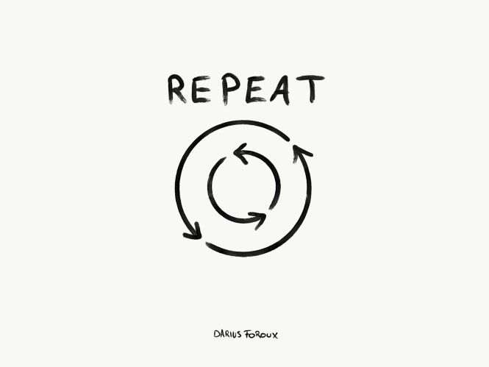


Re-inforce
Repetition
Highlight portlet
Cycle through user’s highlights
Re-inforcement
Jog memory
Support additional context
Retention
Increase knowledge lifetime
Increase engagement

Slide 17
If you don’t use it
AND switch contexts,
but use Highlights,
you lose it veeeery slowly!
Reality
with Highlights

Slide 18
2022 User Group Program
What is the plan for user groups in 2022?
We are excited to bring back our live in person regional user group format to our customers in 2022. After having surveyed our customers (by region) we feel that with over 25 responses per region we have an idea of what the program success will be and which locations are ready to attend an in-person event.
Notes:
We are Targeting areas that are known for having a lot of our customers and that have an average of over 25 attendees
Some early research Q1
The first 3-4 cities in Q1 will really be a test as I will reflect and evaluate how it went before, we move continue the Program in Q2 (we will still be advertising for these shows in Q2 while we evaluate what Q1’s results).
-There will be surveys at the user groups which will be the main data point as well as attendance.
Customers by location what do I want attendance wise (what %)

Slide 19
Repetition
Re-inforces
Retention

Slide 20
2022 User Group Program
What is the plan for user groups in 2022?
We are excited to bring back our live in person regional user group format to our customers in 2022. After having surveyed our customers (by region) we feel that with over 25 responses per region we have an idea of what the program success will be and which locations are ready to attend an in-person event.
Notes:
We are Targeting areas that are known for having a lot of our customers and that have an average of over 25 attendees
Some early research Q1
The first 3-4 cities in Q1 will really be a test as I will reflect and evaluate how it went before, we move continue the Program in Q2 (we will still be advertising for these shows in Q2 while we evaluate what Q1’s results).
-There will be surveys at the user groups which will be the main data point as well as attendance.
Customers by location what do I want attendance wise (what %)

Slide 21
States and Dates
These are level 1 bullets
These are level 2 bullets
These are level 3 bullets

Slide 22
Agenda
8:00 - 9:00 Sign in and Breakfast – Check Double Vaccination Customer Success Rep
9:00 - 9:15 Welcome and introductions – Erik outlines the day
9:15 - 9:55 Working group icebreaker – Usually takes close to an hour- IMPORTANT
9:55 - 10:35 Cornerstone/ Saba Cloud / TalentSpace Update – Customer Success to Deliver
10:35 - 10:45 Break
10:45 - 12:00 Breakout Table Discussions –Topics voted on – Customer Success, Erik, and CSOD U
12:00 - 12:45 Lunch and networking
12:45 - 1:15 Breakout Group recap - Erik
1:15 – 2:15 Product Case Study Exercise – on a popular topic led by CSOD/SC University
2:15 - 2:45 Customer Success Stories – show and tell – 1-2 Customers presenting their story
2:45 - 2:55 Break (surveys handed OUT )
2:55 - 3:35 TIPS and TRICKS - Services
3:35 – 4:00 Resources / Next Steps –Erik – closing

Slide 24
These are level 1 bullets
These are level 2 bullets
These are level 3 bullets
These are level 1 bullets
These are level 2 bullets
These are level 3 bullets

Slide 26
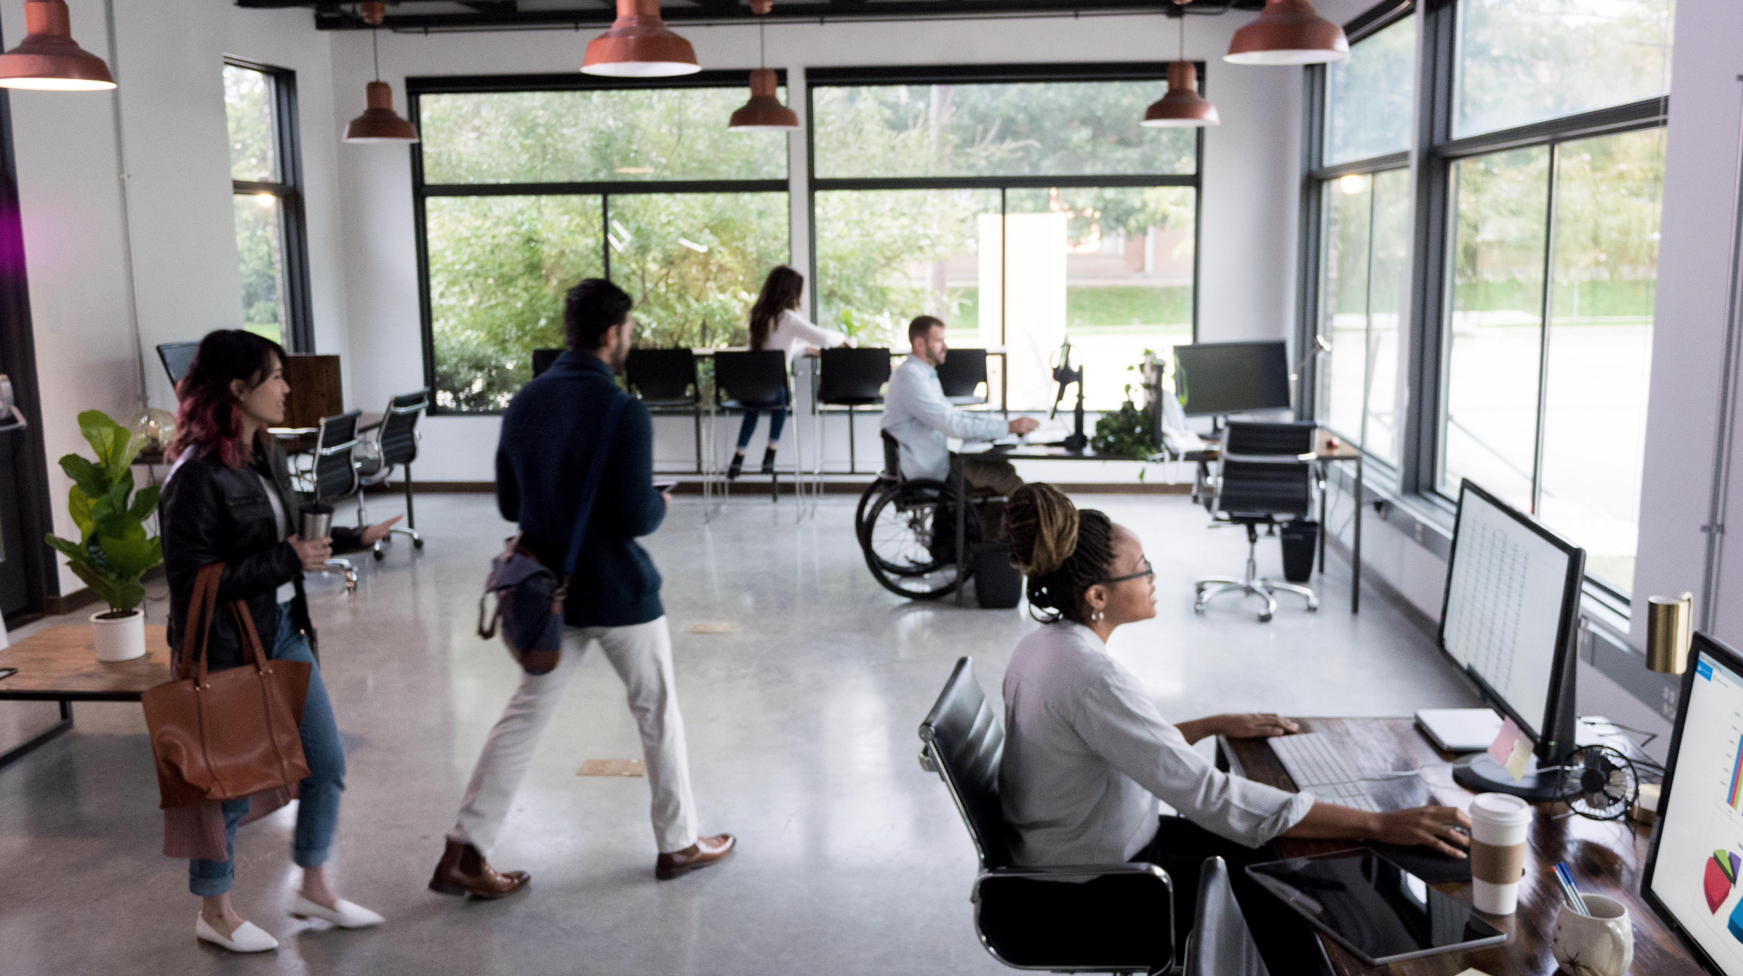

Slide 28



Slide 38
















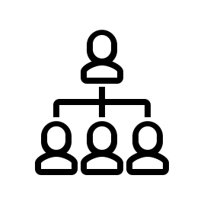





























































Icons
Please only use icons provided in this template

Slide 39














































































Icons
Please only use icons provided in this template

Slide 40
Table

Slide 41
Table

Slide 42
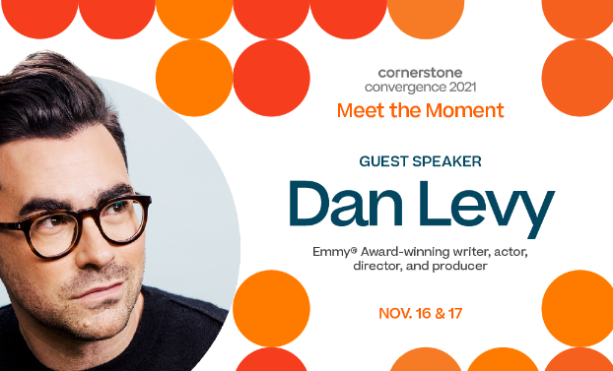
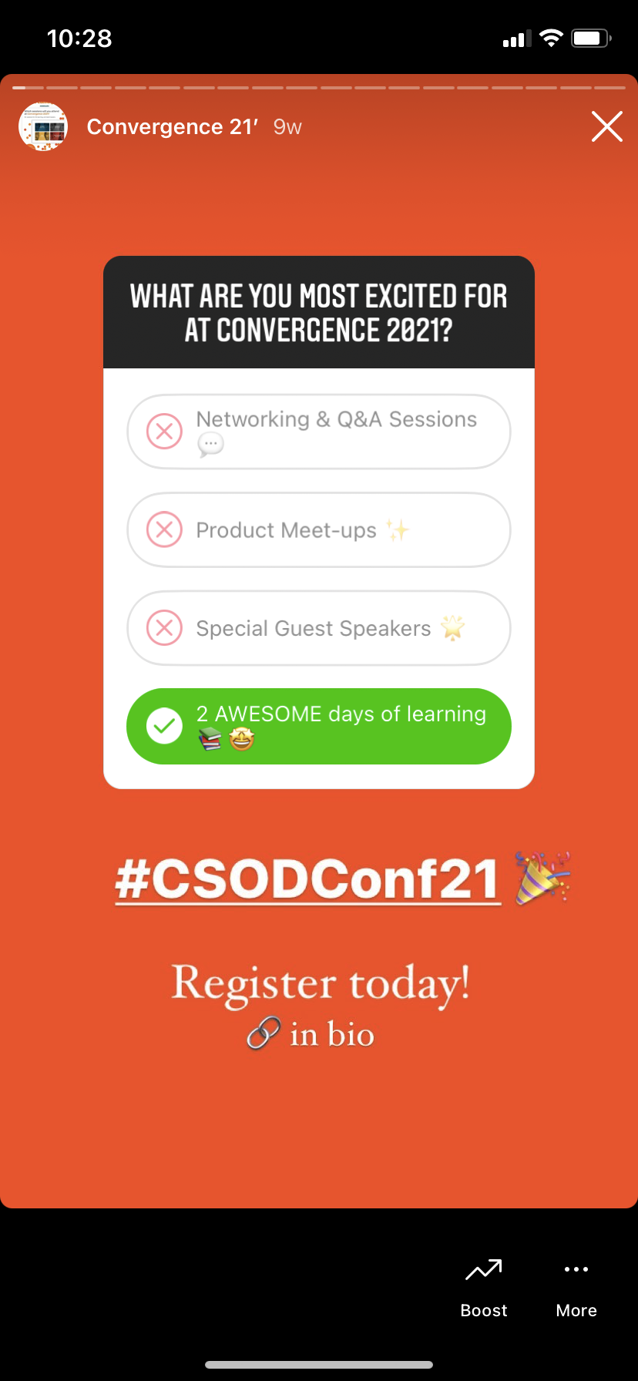
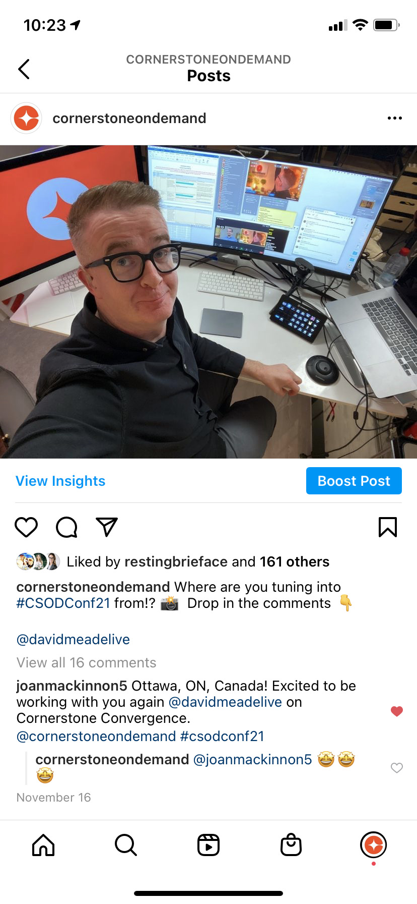

Slide 43
Engagement by Social Channel

Slide 44
Recap slide
Post likes
5,892
Post shares
901
Reach
193,3646
Engagement
7,034

Slide 45


Slide 46


Slide 47


Slide 48


Slide 49


Slide 50


Slide 51
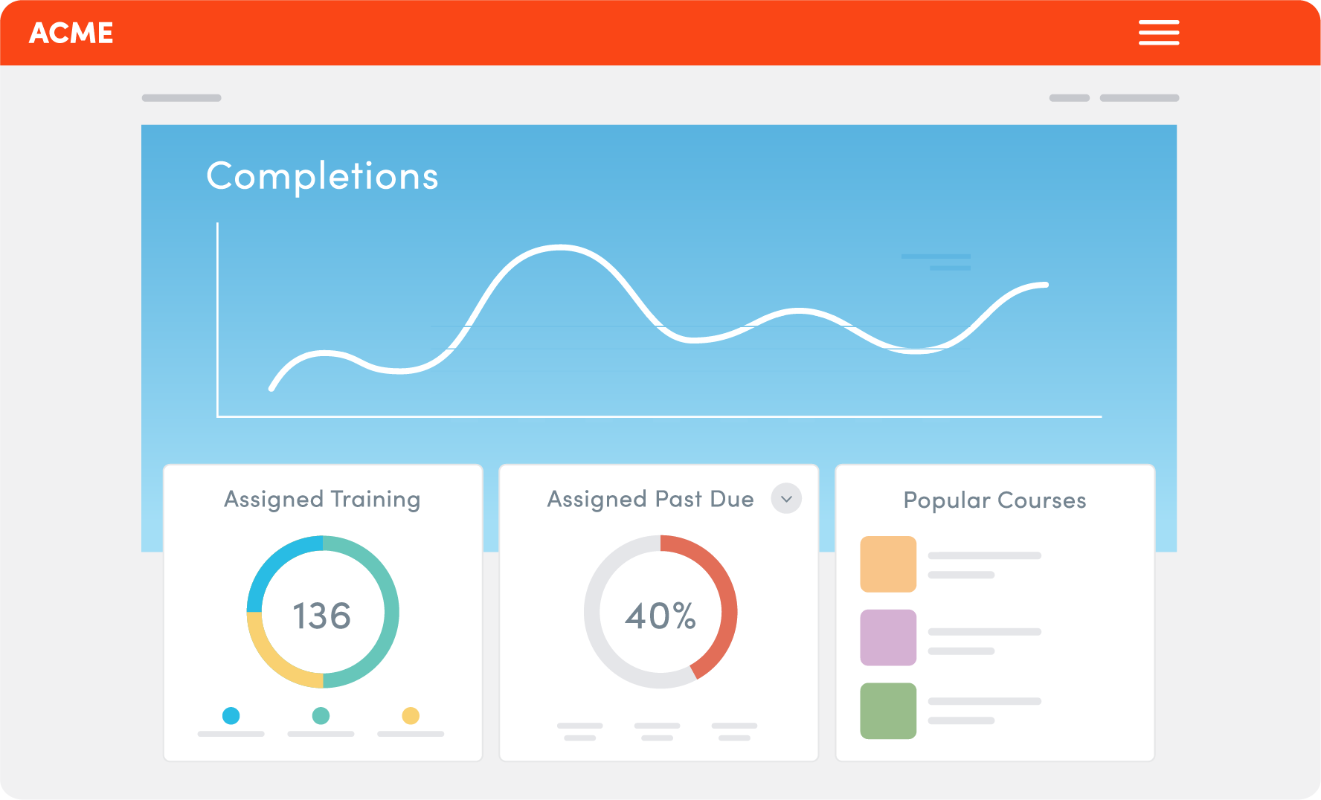
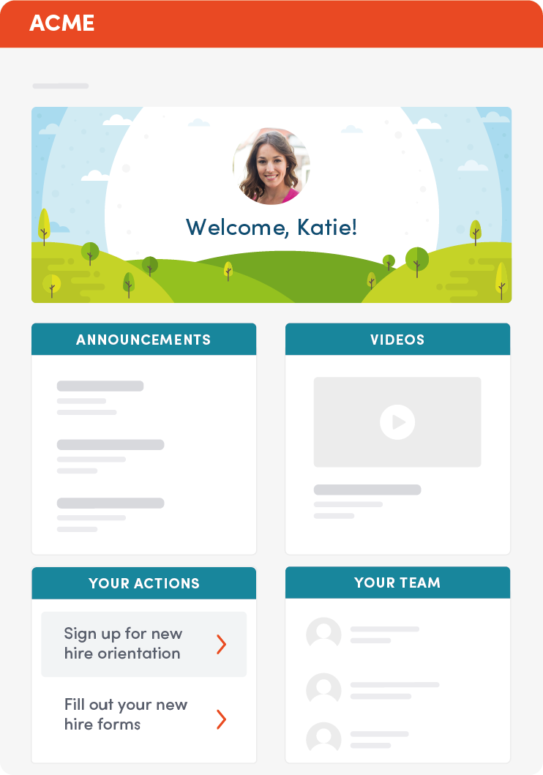
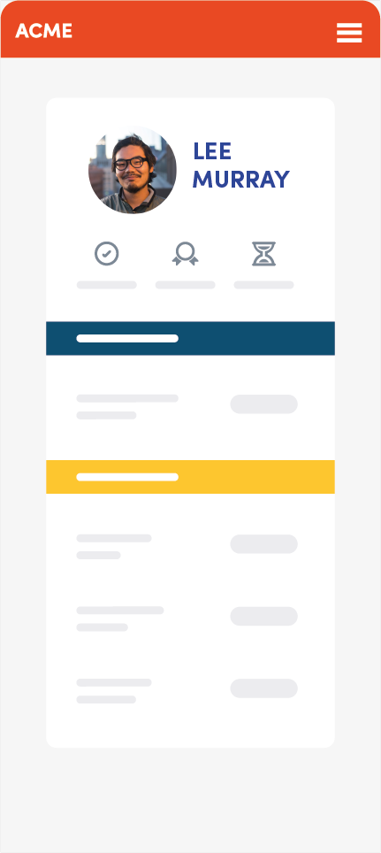
Devices

Slide 52
Thank You!

Slide 53
Questions?
cornerstoneondemand.com
Team Highlights
highlights@csod.com

Slide 54
Questions?

